Slide 1
A Language for Programmable Hardware Security
Chris Casinghino
HILT 2018
Distribution Statement A: Approved for Public Release, Distribution Unlimited.
This work is sponsored in part by DARPA’s System Security Integrated Through Hardware and Firmware (SSITH) program under contract HR0011-18-C-0011. The views, opinions, and/or findings contained in this talk are those of the author and should not be interpreted as representing the official views or policies, either expressed or implied, of the Department of Defense or the U.S. Government.

Slide 2
Overview
What languages and tools should we use to program configurable hardware security features?
The plan in three parts:
“Configurable hardware security features”?
How are we doing it right now?
What are the next steps?

Slide 3
DARPA SSITH/HOPE Team
Arun Thomas, Chris Casinghino, Arch Owen, Curtis Walker
UPenn
André DeHon
Benjamin Pierce
MIT
Howard Shrobe
Portland State
Andrew Tolmach
Dover Microsystems
Greg Sullivan
Andrew Sutherland
Dornerworks
Nathan Studer
INRIA
Cătălin Hriţcu

Slide 4
1) What is “configurable hardware security”?

Slide 5
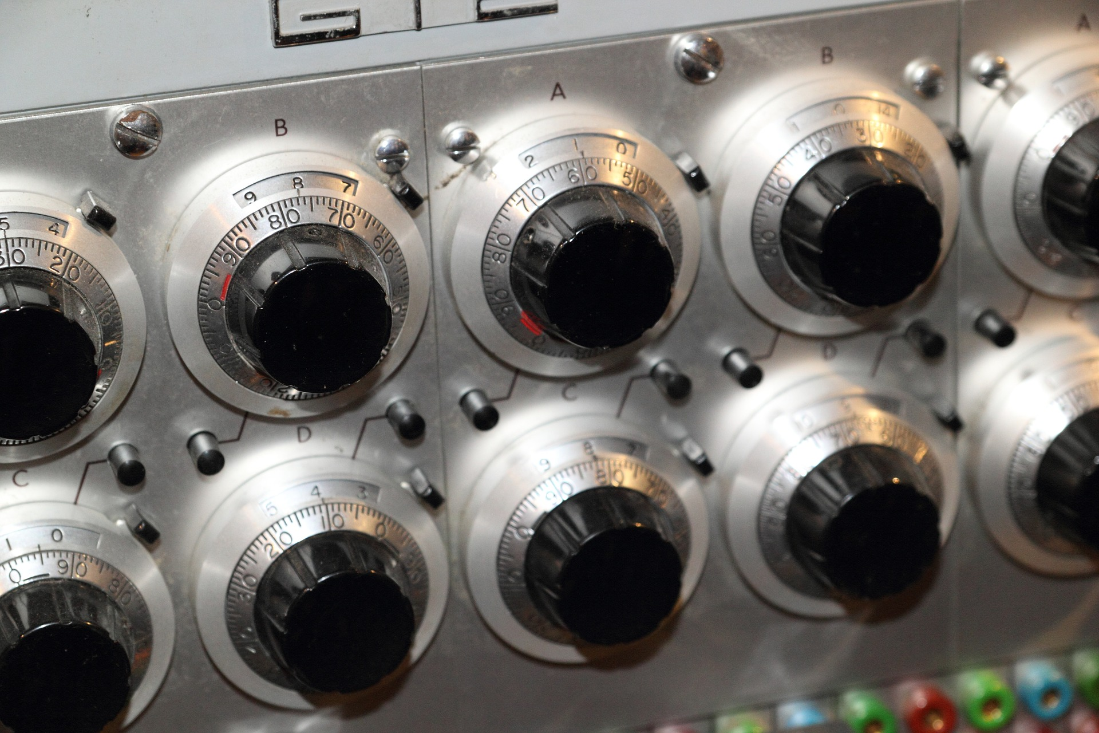
Problem: Hardware doesn’t adapt.
Software security models and attacker techniques change often.
Hardware can provide strong security guarantees for software.
But today’s hardware security features defend against yesterday’s threats.
Solution: design hardware to enforce a configurable policy.
SMEP
(2011)
SMAP
(2012)
MPX
(2013)
SGX1 (2013)
SGX2 (2014)
MPK (2015)
CET (2016)
Recent Intel Security Feature Timeline

Slide 6
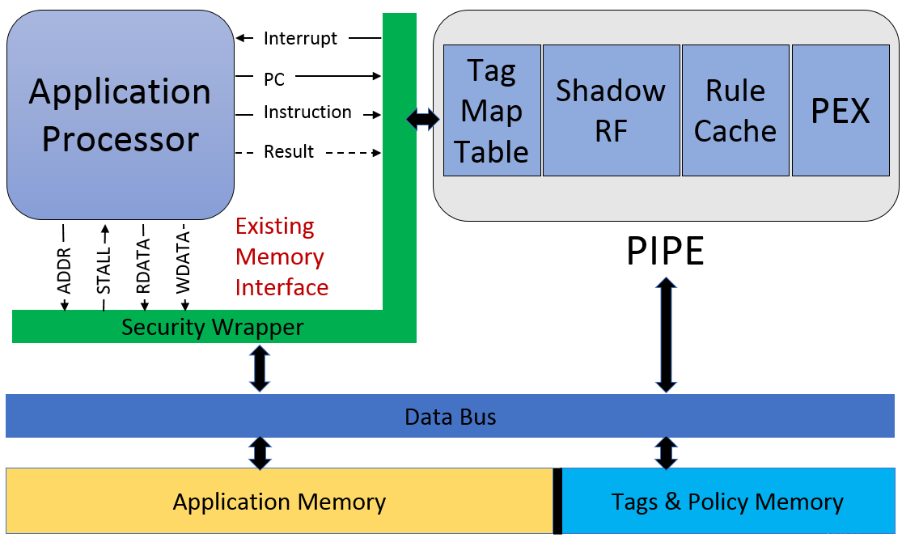
Configurable security: Draper’s PIPE
PIPE is a security co-processor that monitors your application processor.
Programmable Metadata Tags
Each data word has a programmable tag.
Can’t be modified by user application.
Micro-policies
Define security, safety, or correctness requirements.
Processor Interlocks for Policy Enforcement (PIPE)
Unassailable hardware interlock enforces policies.
Runs parallel to application processor.

Slide 7
Key Idea 1: Metadata Tags
Each memory word and register has a programmable metadata tag.
At every instruction, tags for the relevant memory and registers are passed to the PIPE.
Application cannot directly create or modify tags.
Tags can be pointers to arbitrary data structure, enabling complex policies.
Instruction, user data, etc.
metadata tag | data payload
Example metadata:
Provenance
Access rights
Object type
Executable?
Legal branch target?
Buffer bounds

Slide 8
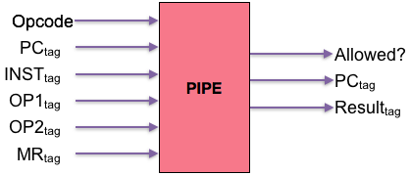
Key Idea 2: PIPE hardware
The PIPE runs in parallel with usual “application” processor.
Its inputs are metadata tags, which are evaluated against a defined policy.
Generates application processor interrupt if policy violation occurs.
Creates unassailable hardware interlock blocking execution of bad instructions.
Cache keeps performance high.

Slide 9
RISC-V Inside
Today we’re building on RISC-V.
RISC-V is an open architecture, great for experimentation.
Also beginning to see use in practice; we’re optimistic.
Work also in progress on ARM, other RISC architectures (PowerPC, MIPS) possible.
RISC-V
Cores

Slide 10
Key Idea 3: Micro-policies
Example Policies
Heap Safety
Read-Write-Execute
Control-flow Integrity
Compartmentalization
Information Flow Control
Domain-specific policies
Policies define what instructions are allowed and how metadata is updated.
Policies are written in a domain-specific rule language.
PIPE sends metadata tags to policies running on the policy execution core.
Policies check metadata against installed rules and reject bad behavior.

Slide 11
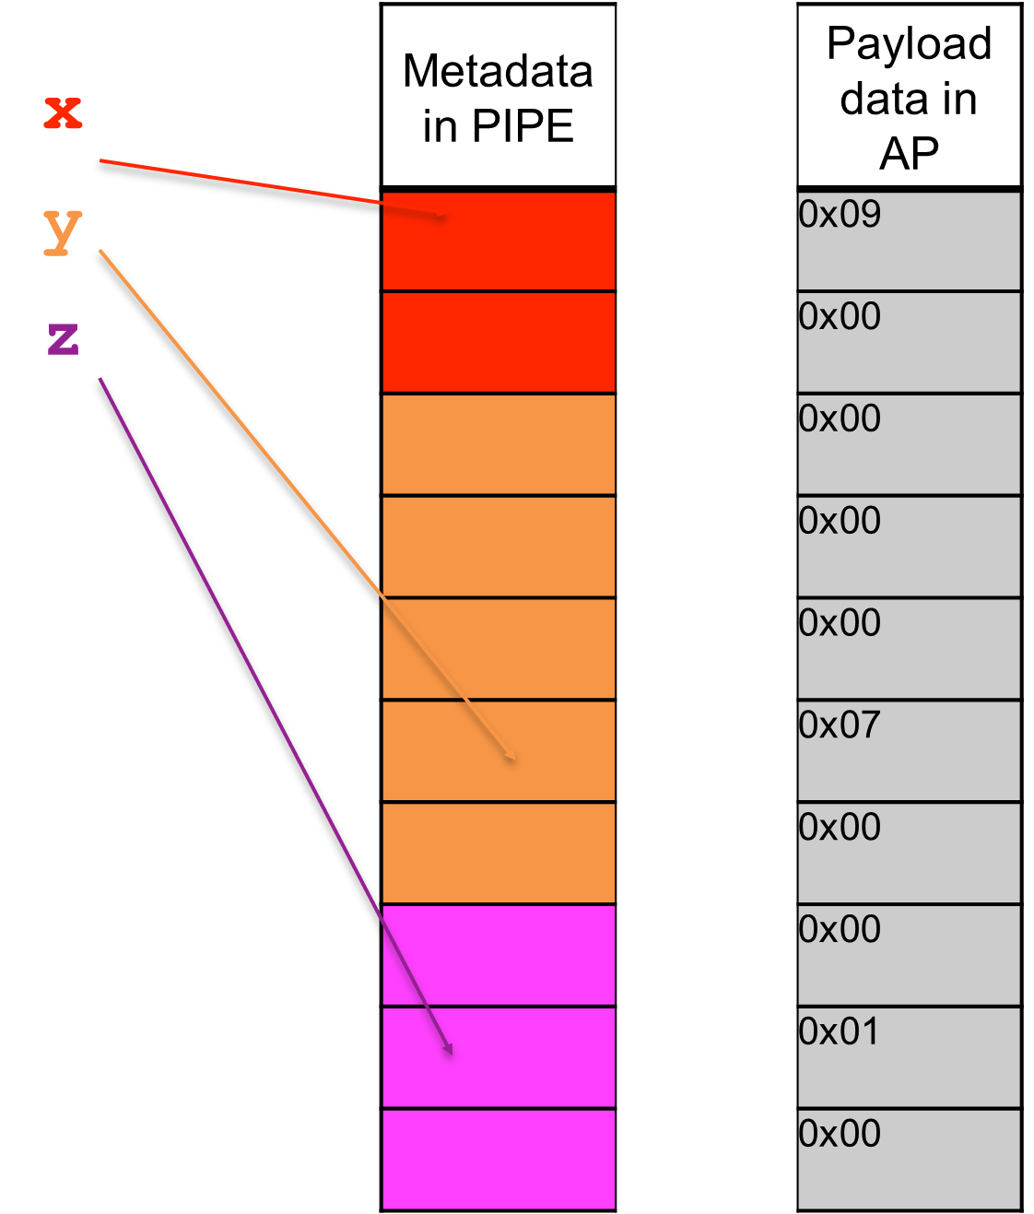
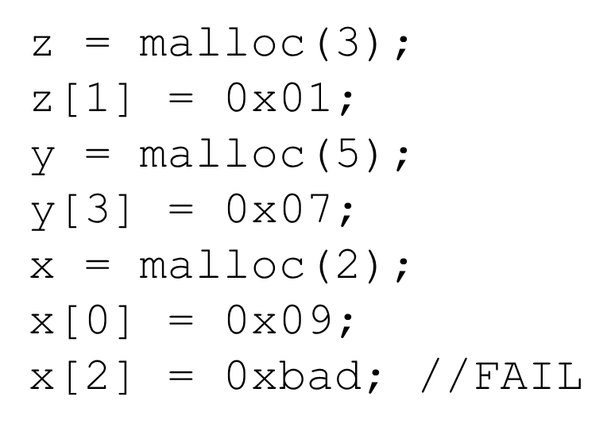
Micro-policy Example
Policy Goal: enforce spatial and temporal safety
Method: “color” pointers and memory
On allocation, add colors to the region and the pointer.
Recolor on free.
Policy:
When accessing memory, the pointer and the region must have the same color.

Slide 12
PIPE History and Foundation
DARPA
CRASH
In 2010, DARPA launched 5-year, $100M CRASH program (“Clean-Slate Design of Resilient, Adaptive Secure Hosts”).
Largest effort let by team at BAE Systems, built new “SAFE” architecture.
The SAFE team joined Draper in 2015 to take 5 years of research into practice.
Large Draper internal investment over 2 years resulted in redesign as “add-on” modifications for existing cores.
Technology built on open, emerging RISC-V architecture for initial development.
In 2017, spin-out Dover Microsystems created to pursue commercial markets and collaborate with Draper on maturation.
DARPA
SSITH
System Security Integrated Through Hardware and firmware (SSITH).
Development of hardware security architectures to protect against 7 classes of vulnerabilities.

Slide 13
DARPA SSITH CWE Classes
Micropolicies are general enough to defend against all 7 SSITH vulnerability classes:
Buffer errors
Permissions, Privileges and Access Control
Resource Management
Code Injection
Information Leakage
Crypto Errors
Numeric Errors

Slide 14
2) How do we write policies today?

Slide 15
What is a policy?
A policy is a program that runs on the PIPE.
It determines whether an instruction is allowed based on the current metadata tags, and updates the metadata if so.
Any general-purpose programming language could be used to write policies.

Slide 16
In the beginning there was C
C is not a good languages for writing policies.
Error prone: Policies tend to follow a very regular structure, and C makes it hard to notice small mistakes.
Too verbose: Boilerplate obscures important parts. Did I already handle this case?
Not modular: Policy assumptions about tag layouts and global state make it tricky to combine policies.
Hard to verify: Formal verification tools for C are rapidly improving, but they are complicated by C’s generality, which we don’t need.

Slide 17
Solution: A Policy DSL
The “patterns” define constraints on the current metadata.
The “require” section defines how memory is tagged at boot.
Metadata is a set of user-defined values.
A rule can update relevant metadata. (This one doesn’t.)
This rule applies to instructions in its “opgroup”.
metadata:
Rd | Wr | Ex
policy:
rwxPol =
loadGrp ( code == [+Ex], env == _, mem == [+Rd]
-> env = env)
^ storeGrp ( code == [+Ex], env == _, mem == [+Wr]
-> mem = mem, env = env)
^ nonMemGrp ( code == [+Ex], env == _
-> env = env)
require:
init Link.MemoryMap.UserStack = {Rd, Wr}
init Link.MemoryMap.UserHeap = {Rd, Wr}
init Elf.Section.Code = {Ex}

Slide 18
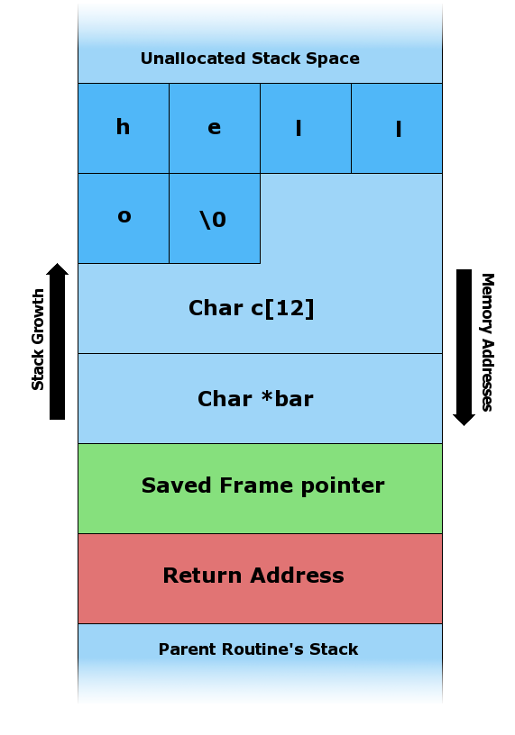
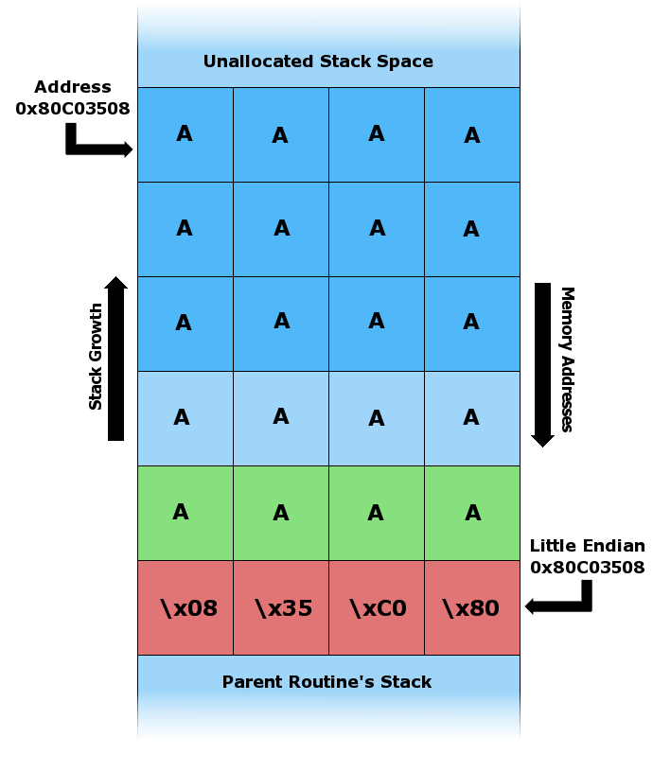
Example: Stack Buffer Overflow

Slide 19
Stack Protection Policy
Tag memory containing function prologue and epilogue code.
No other code may touch stack frame.
metadata:
Frame | Prologue | Epilogue
policy:
stackPol =
// Prologue creates stack Frame
storeGrp ( code == [+Prologue], mem == _, env == _
-> mem = {Frame})
// Other code can’t touch Frame
^ storeGrp ( code == [-Prologue, -Epilogue], mem == [+Frame]
-> fail "Illegal stack access")
// Epilogue clears Frame, allow other writes, ...
...

Slide 20
Final Example: Simple CFI
Statically determine legal jump destinations.
Dynamically check each jump.
metadata:
Target | Jumping
policy:
stackPol =
// jump instructions set “Jumping”
jumpGrp (env == _ -> env = env[+Jumping])
// Landing on legal target clears “Jumping”
^ allGrp ( code == [+Target], env == [+Jumping]
-> env = env[-Jumping])
// Landing elsewhere is a violation
^ allGrp ( code == [-Target], env == [+Jumping]
-> fail "Illegal jump")
^ ...

Slide 21
Policy Language Continued
Users may define new “opgroups”.
Group instructions in the way that makes sense for your policy.
Keeps policy rules somewhat ISA-agnostic.
Policy metadata can include data (not just binary tags).
E.g., “colors” for heap memory safety policy.
Language implemented in Haskell.
We generate C and compile to RISC-V binaries to run on PEX.
Lots of room left to optimize.
Language has formal operational semantics.
Future goal: prove implementation correct.

Slide 22
3) Active research in policy language design and verification.

Slide 23
C-level Policy Language (Andrew Tolmach @ Portland State)
Lift expression of policies from machine-level instructions to C constructs.
Policies are expressed as constraints “on the side” on a per-project basis (minimal modification to programs themselves).
We modify a C compiler to generate tagged machine code that enforces the policies on PIPE hardware.
Suitable for policies that are not already “built in” to C, including IFC, compartmentalization, memory safety.
Formally, we enrich C semantics to enforce policies, and can (potentially) prove that compiler preserves enforcement.

Slide 24
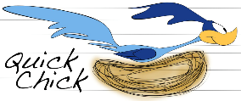
Property-Based Random Testing for Micropolicies (Benjamin Pierce @ U Penn)
Background: QuickCheck automated testing framework.
User states a property that code should have, QuickCheck generates random test cases.
QuickChick is verified QuickCheck for Coq.
Existing work by Hritcu, Pierce, and others.
Previously used for checking IFC properties.
Research Goal: Apply QuickChick to rapidly test micropolicies.
Observation: Essential to test before attempting a proof.

Slide 25
QuickChick for Micropolicies First Steps
Components defined in Coq:
Simple tagged RISC machine.
Memory safety and stack safety policies.
Properties to check: noninterference.
Memory safety noninterference property:
For any program p, and memory states s1 and s2.
Assume the “reachable” portions of s1 and s2 are identical.
Then, if p obeys the policy, it should produce states s1’ and s2’ that have identical reachable portions.
Testing framework generates random programs that exercise policy.
Also checks that buggy policy variants (“mutants”) violate property.

Slide 26
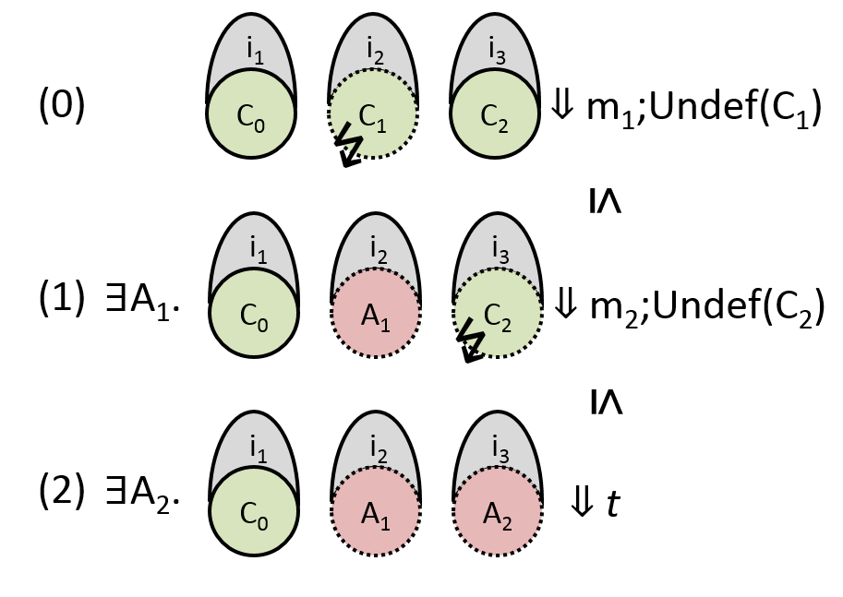
Compartmentalization via PIPE (Catalin Hritcu @ INRIA)
Intuitively, compartmentalization is a general mitigation mechanism.
An “insecure” component should not “affect” other components.
There are many different ways to make this precise!
One option: dynamic compromise.
Details in “When Good Components Go Bad”. Fachini, Stronati, Hritcu, et al. CCS 2018.

Slide 27
Future μ-Policy Verification Tools
High-level security, safety and correctness properties
Installed μ-policies (Policy DSL)
2
refines(1,2)?
OK?
Control-Flow Integrity
1
Heap memory safety
Policy DSL Semantics
Stack safety
Taint tracking
Generates or Verifies
Other CWE
Policy Compiler
Composed Policy (RISC-V binary)

Slide 28
Conclusion
Summary:
Configurable hardware mechanisms (like tagged architectures) can provide powerful, evolving security features.
DSLs can make security policies easier to write and trust.
There is lots of room left for interesting research in this area.
Thanks!

